Slide 1
Health Insurance vs Death Rates
Johnny Lee, Ella Weinberg, Carolyn Christopher Chen

Slide 2
Introduction
The United States is notorious for its citizens unhealthy lifestyle choices that lead to higher rates of chronic diseases and deaths. Alongside the poor lifestyle choices, the US healthcare system is expensive and inaccessible for many citizens. According to the Commonwealth Fund, the US has the most expensive healthcare system but ranks last in terms of efficiency, equity, and healthcare outcomes. The goal of health insurance is to help protect people from paying these high medical bill costs out of pocket. Unfortunately, the issue with insurance is it can also be expensive, has gaps in its coverage, and policies are not accessible for all. In this project we analyze two datasets, one portraying the 10 leading causes of death in each state, and one examining the types of healthcare coverage that citizens have in each state. The goal is to examine what the relationship between the types of healthcare citizens use, and if that impacts the health related deaths. Part of our analysis focus specifically on the relationship between low income insurance/no insurance and if that impacts health related deaths. This potential correlation is of interest to a wide variety of people such as US citizens, insurance companies, and health policy makers.
Notes:
Ella

Slide 3
Datasets
01
02
Leading Causes of Death: United States
Health Insurance Coverage of the Total Population
Source - Kaiser Family Foundation and Census Bureau's American Community Survey. Available to the public
Overview - Breaks down what percentage of people in each state had which type of health insurance from 2008 - 2017
Data Columns - Year, State, Employer, Non-Group, Medicaid, Medicare, Military, Uninsured, Total
Data Quality - very good, collected by a reputable source with no N/A values
Source - US Department of Health and Human Services, published by CDC. Available to the public
Overview - Data based on death certificates from all 50 states that presents the death rates for the 10 leading causes of death in the US from 1999 - 2017
Data Columns - Year, 113 Cause Name, Cause Name, State, Deaths, Age-adjusted Death Rate
Data Quality - very good, collected by a reputable source with no N/A values
Notes:
Johnny

Slide 4
Merged Data
Merge key: Year and State
Filter: all the years before 2008 (filtered out)
Rows: number of deaths and health insurance distribution percentages for a specific cause of death in a state per year
New Numerical Variable: Region & Low_Income_Insurance
Variables:
Year - Year data from 2008 to 2017
Cause Name - The specific cause of death
State - The state data
Deaths - Total number of deaths from a cause for a state in the US
Age-adjusted Death Rate - Number of deaths per 100,000 relative to state or country population
Employer, Non-Group, Medicaid, Medicare, Military, Uninsured - The types of insurance people could have (%)
Region - A way to group states according to their geographic position so we can analyze trends by grouping the region
Low_income_insurance - The sum of Medicaid and Uninsured percentages.
Notes:
Carolyn
In merging our two datasets our merge key was the Year and State, but since the leading death rate dataset had a wider span of years we filtered out all the years before 2008. This made merging the data very easy and each row in the merged dataset represents the number of deaths and health insurance distribution percentages for a specific cause of death in a state per year. Region and Low_Income_Insurance is the new numerical variable we created.

Slide 5
Summarized Data
The second data frame that was used in our analysis was a summarization data frame consisting of variables inherited or derived from the datasets we had selected/merged and aggregations of data points. It consists of yearly data from 2008-2017 of average regional deaths per 100,000 for all causes of death and average uninsured percentage. Each row in the data frame describes the average deaths per 100,000 and average uninsured percentage of a given region in a given year.
Year - Provided by merged dataset, year data is associated with
Region - Calculated in previous step and inherited from merged dataset, region of the United States a state is associated with
Avg_age_adjusted_death_rate - New variable derived from joined dataset, average number of deaths per 100,000 for a given region for all causes of death
Avg_uninsured_rate - New variable derived from joined dataset, average percentage of individuals in a given region who are uninsured
Notes:
Johnny

Slide 6
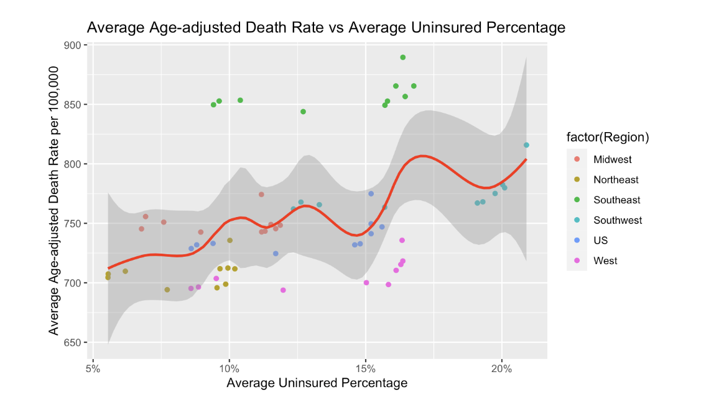
Question 1
How does the average uninsured percentage by regions in the US affect the average number of deaths per 100,000 between 2008 and 2017? Does higher uninsured percentage lead to higher number of deaths on average?
Our visualization allows us to see that higher uninsured rates lead to higher death rates. This trend is consistent when looking at regional trends and for the country as a whole.
Notes:
Ella

Slide 7
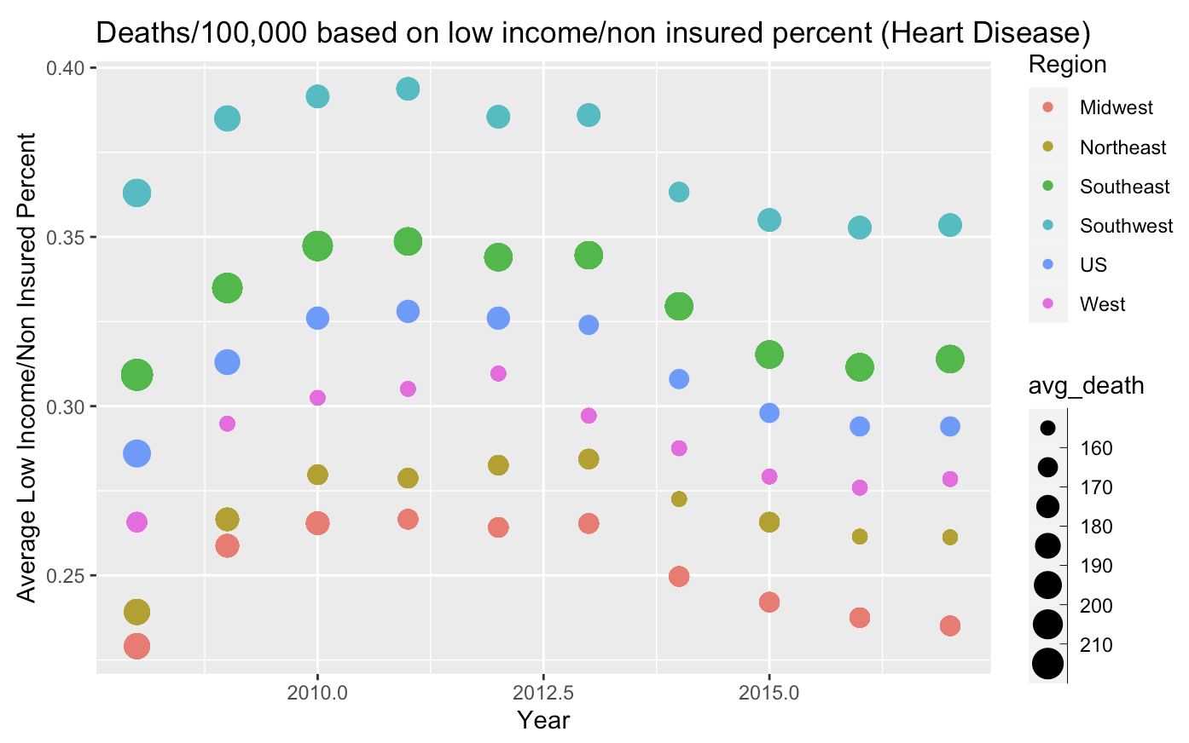
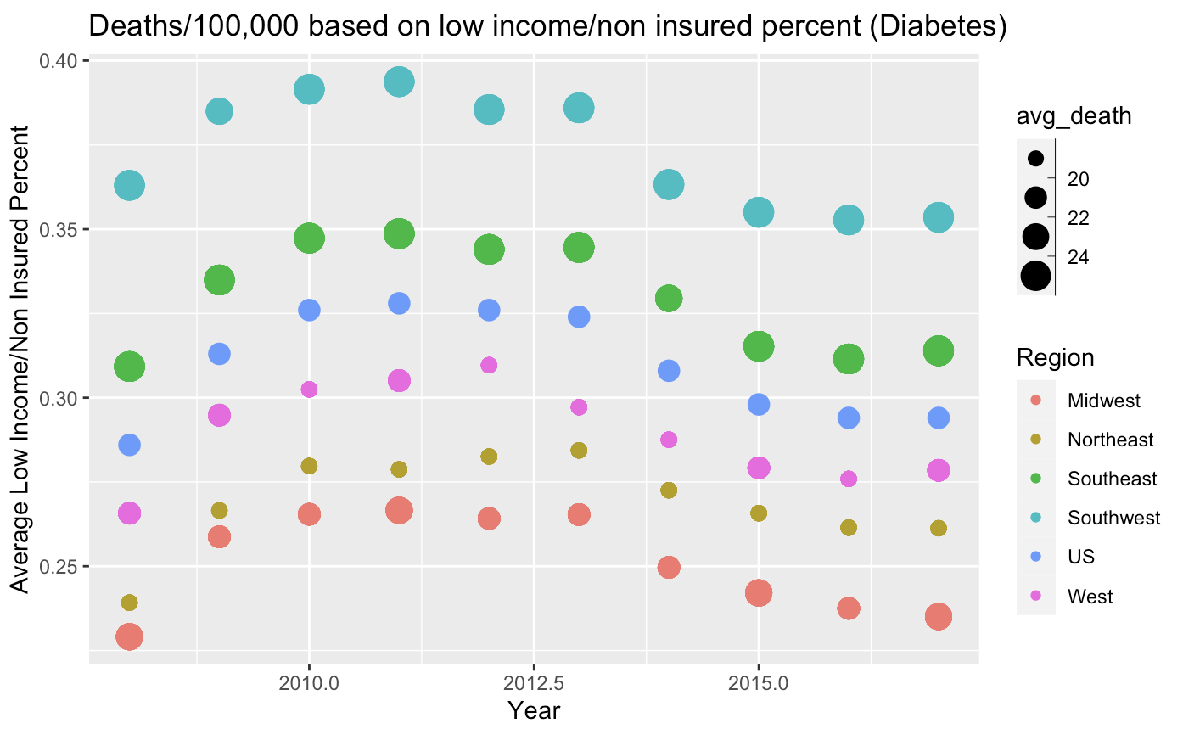
Question 2 Part 1
Do regions with higher percentages of “low income insurance/no insurance” have higher rates of deaths by diseases that could be medically treated/prevented like heart disease and diabetes?
Notes:
Johnny

Slide 8
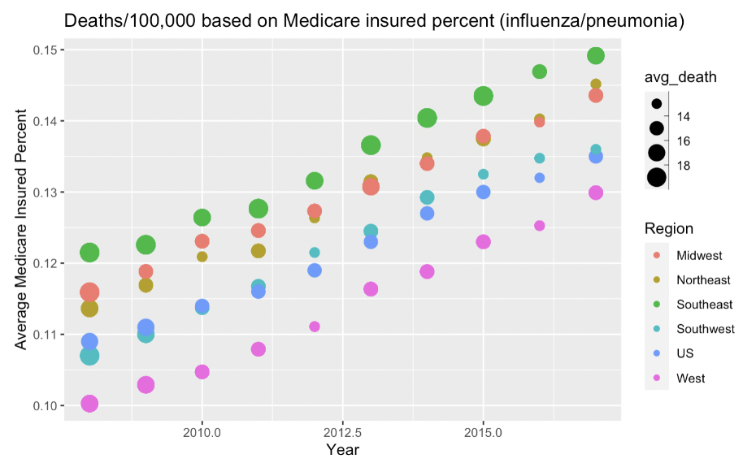
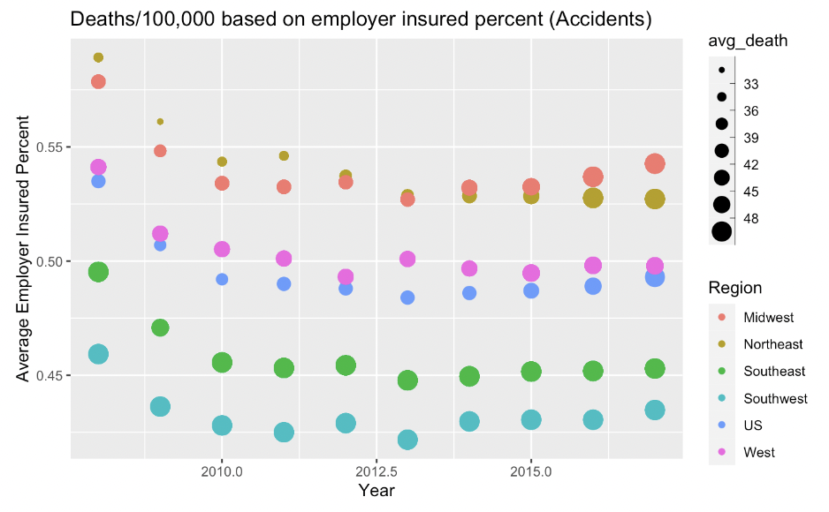
Question 2 Part 2
Are there relationships between certain health insurance types and deaths that are commonly associated with the population that holds said insurance type?
Notes:
Johnny

Slide 9
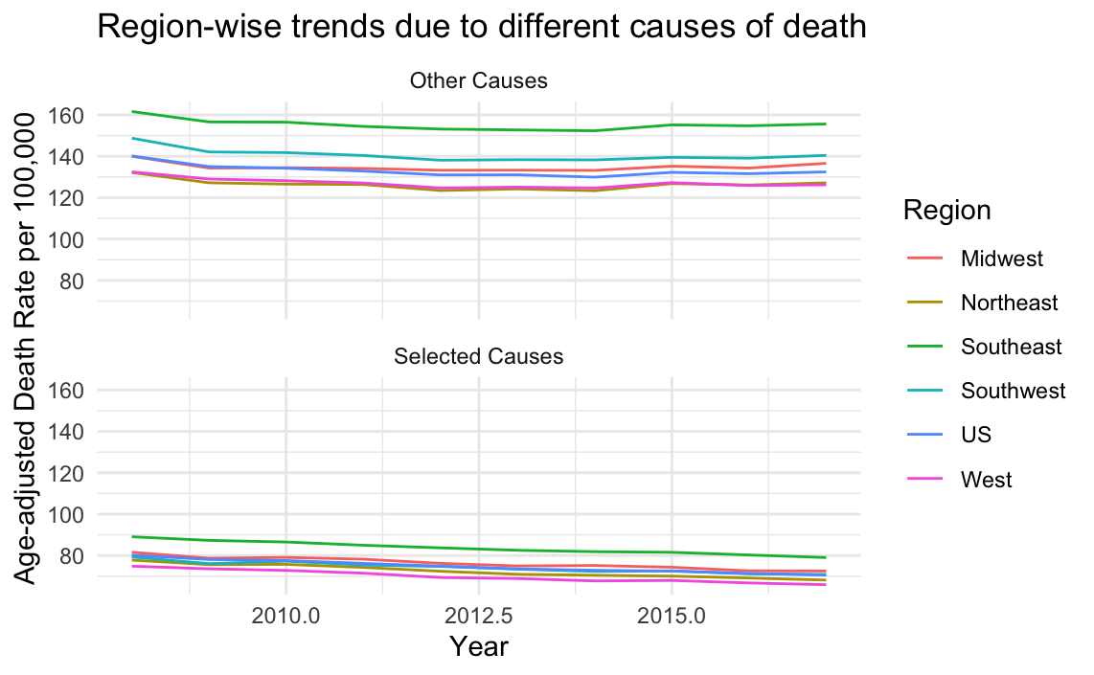
Question 3
Does a specific region of the US have higher average deaths per 100,000 in categories like heart disease, stroke, and cancer which could be medically linked to each other? Do we see trends in other causes of death in specific regions of the US?
Notes:
Carolyn
In this following plot, we decided to show the differences in average deaths from cancer, stroke, and heart disease in comparison to other causes of death. Each line and color represents a region and flows by the year.

Slide 10
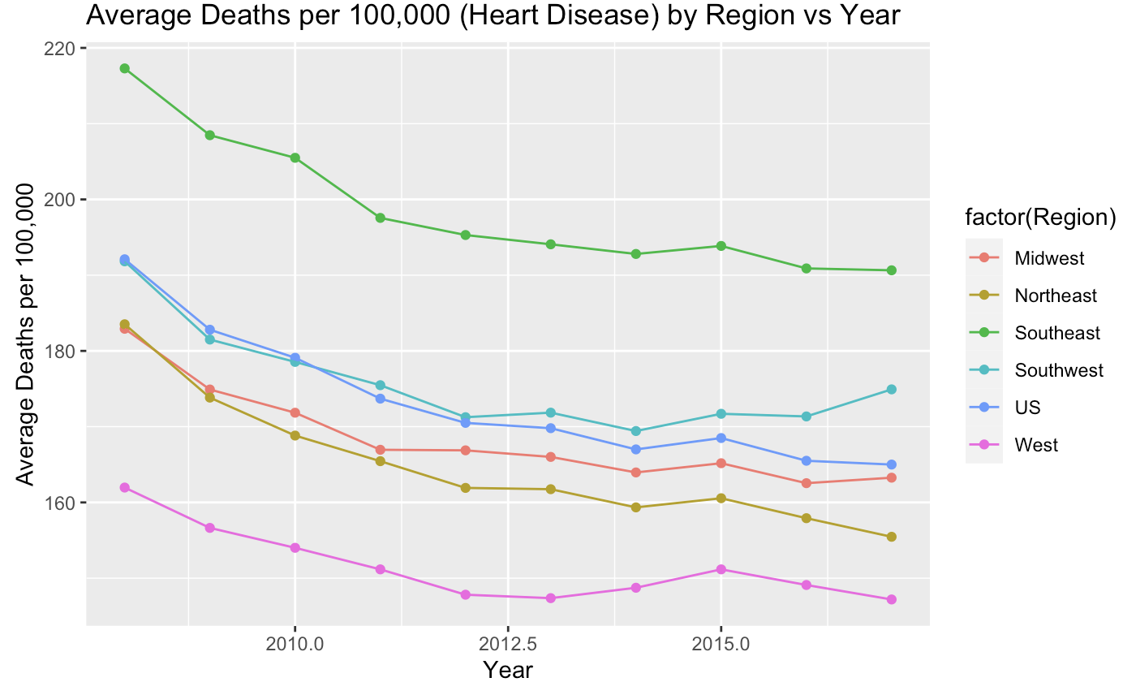
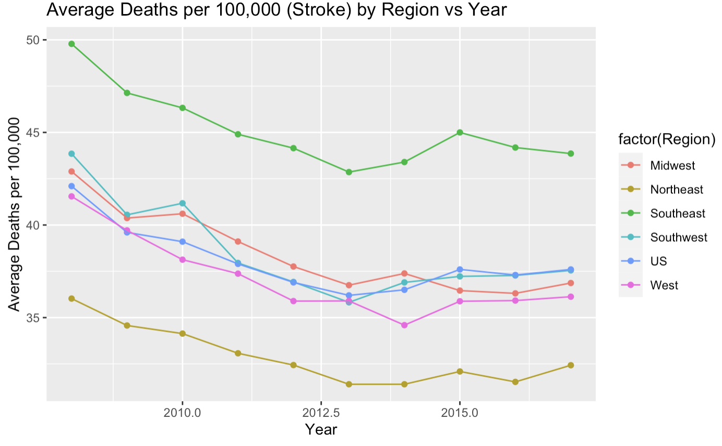
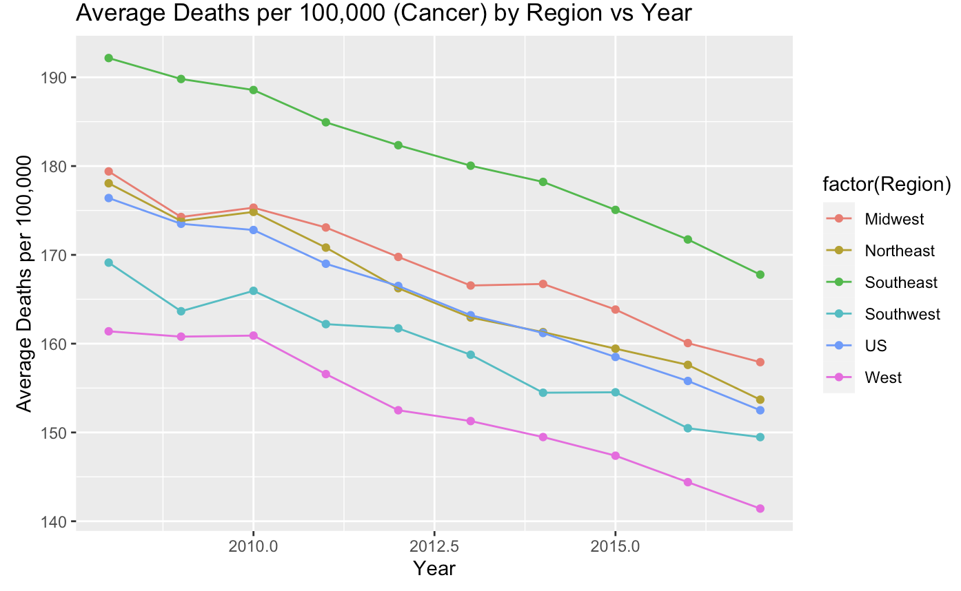
Q3: Selected Causes
Notes:
Carolyn
As seen in the Heart Disease category, all the lines point downward showing a negative trend as the years go by. There is a decrease in average deaths per 100000 for heart disease by year. We can also see that the Southeast region had the most.
In the Stroke plot, it is also a clear statement that the SouthEast region had the highest trend of deaths by about 7 deaths compared to the SouthWest region. Although this also shows a downward trend, it is visible that there was a small peak or increased in the year 2015. Which may mean that there are similar factors in the year of 2015 to cause all regions a positive increase; asides from the midwest.
Now we can take a look at the Cancer plot. It is relatively the same with the other plots. However this shows a more stable downward trend compared to the others.
We can also conclude that the SouthEast region had the most number of deaths compared to the other regions in all of these plots. It is implying that either the SouthEast region is more unhealthy due to factors like the climate, lifestyle,and diet. than the other regions or it just has a more population ratio compared to the other regions. However, it is a positive plot showing that the regions get healthier by the year.

Slide 11
Takeaways
Question 1:
Higher uninsured percentages generally lead to higher overall mortality rates due to lack of accessibility to affordable health care
Most extreme example when comparing the northeast and southeast where a 5-10% increase in uninsured percentage caused a 150-200 increase in average deaths per 100,000
Question 2:
Higher percentages of populations on “low income” insurance (uninsured/government assisted) lead to higher rates of death from heart disease and diabetes which we believe to be medically linked
Lack of health check ups mean late detection/lack of education and inconsistent treatment plans causing higher death rates
Higher rates of employer insured coverage lead to less accidental deaths/deaths from unintentional injury
Higher rates of Medicaid coverage lead to less deaths from influenza/pneumonia
Question 3:
West is the healthiest and southeast is the unhealthiest regions to live in, greater risk of heart disease, stroke, and cancer
All regions have shown improvement in death prevention from 2008-2017 with the southeast showing the most improvement
Clear relationship can be seen between heart disease and stroke, both generally increase or decrease in a given year
Notes:
Johnny

